Slide 1


Leveraging Koopman operator and Deep Neural Networks for Parameter Estimation and Future Prediction of Duffing oscillators. Y. Riyazi, N. Ghanbari, A. Bahrami* Mechanical Engineering department, University of Tehran y.riyazi@ut.ac.ir

Slide 2
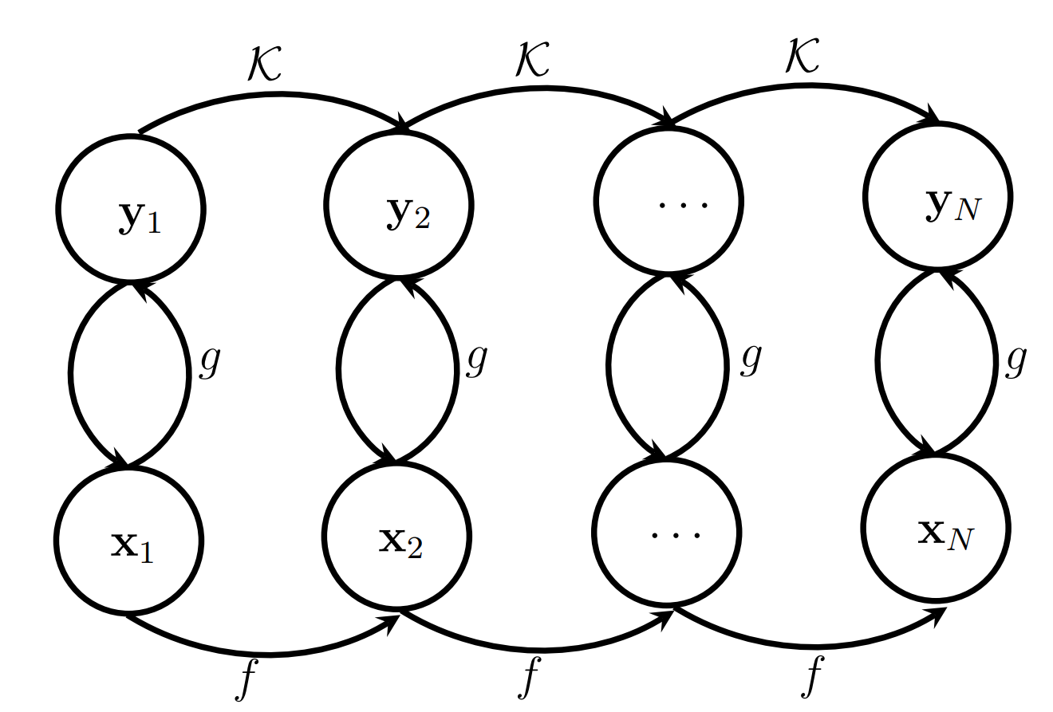

Introduction: The Koopman Operator
$$\dot{x}=f\left(x,t;μ\right)$$
$$\frac{dx}{dt}=f\left(x,t\right)$$
0
0
0
0
0
0
Figure 1. The Koopman Operator (Image by Author).

Slide 3
Introduction: The Koopman Operator

Slide 4
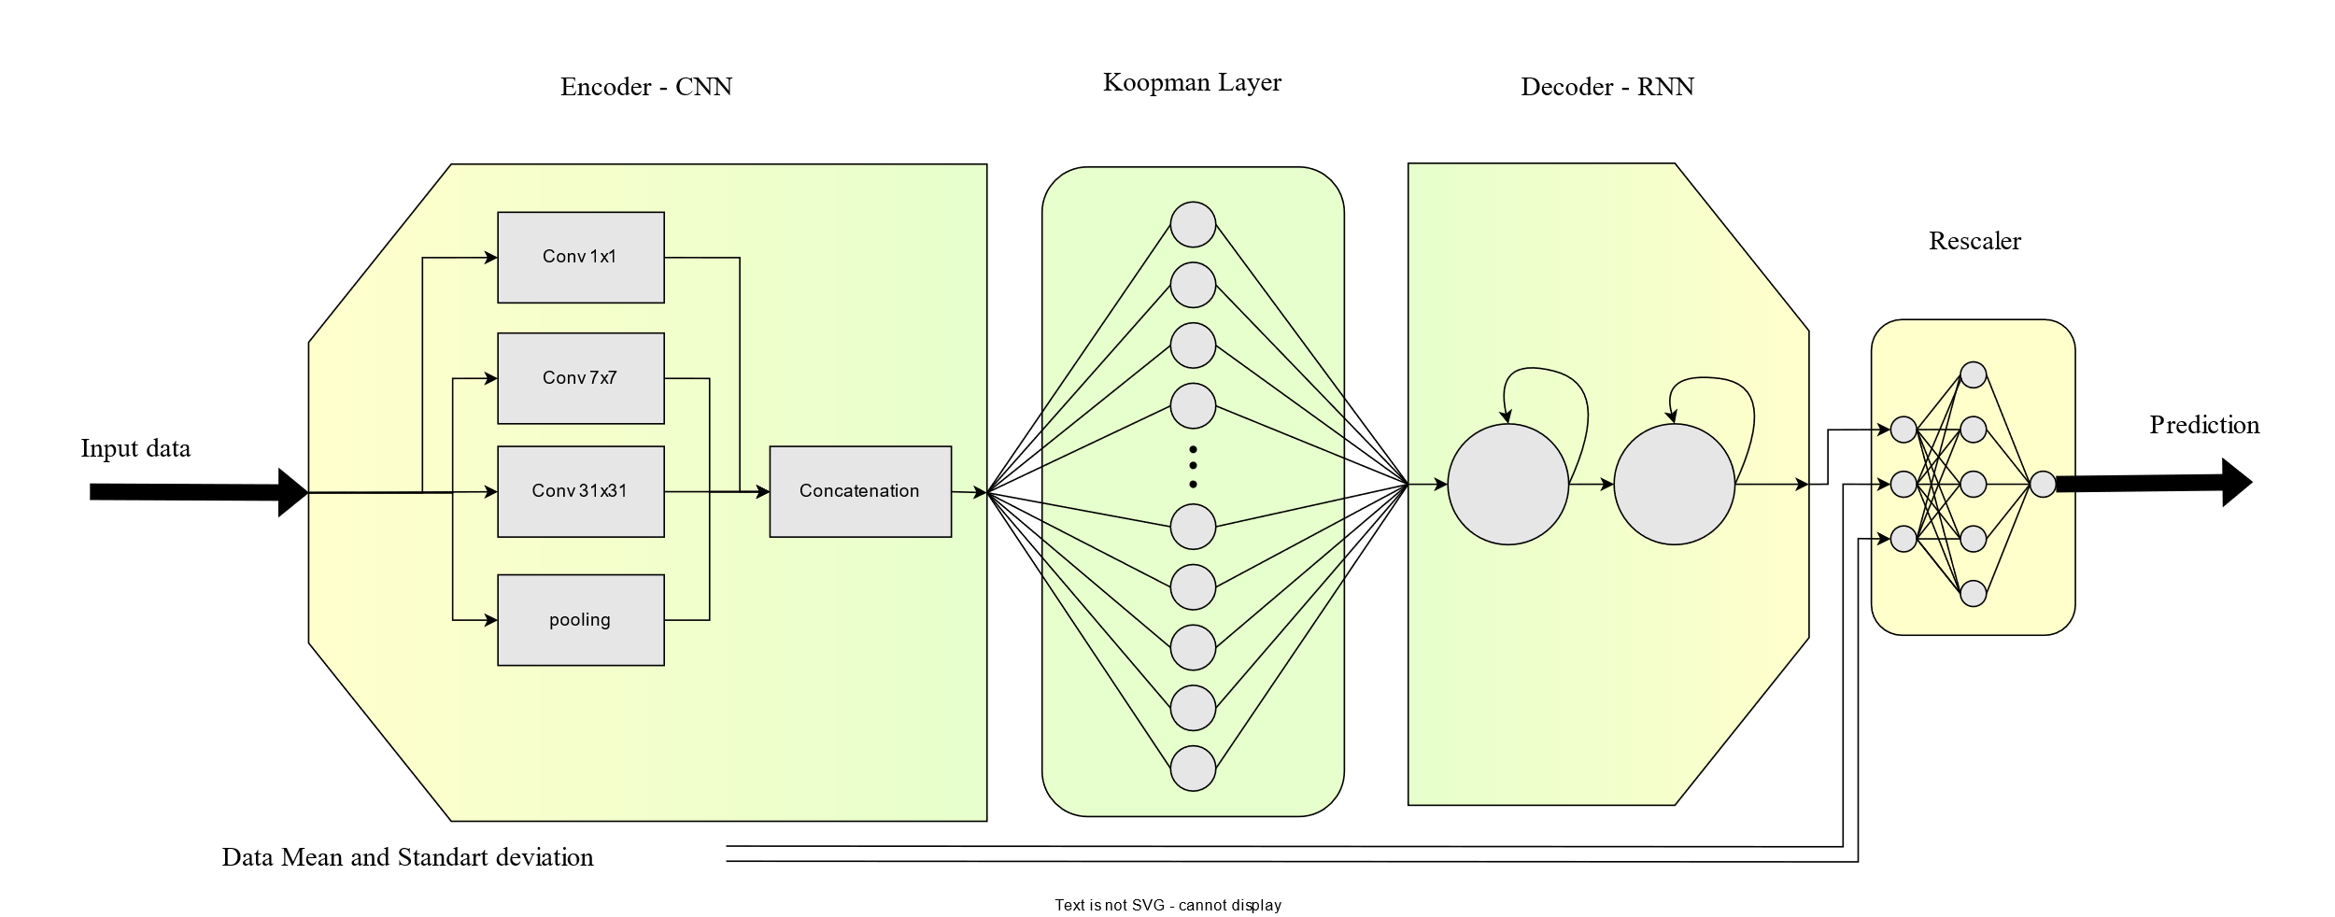
Network: Structure
Figure 2. Network’s Diagram (Image by Author).

Slide 5
Network: Encoder
CNN
Similar to Frequency transformations
Considering different Time scales with different Convolutional filter size.
Inception
Considering different Time scales with different Convolutional filter size.
Not dependent to input size
Improving Back propagation Flow
Figure 3. Network’s Diagram (Image by Author).

Slide 6
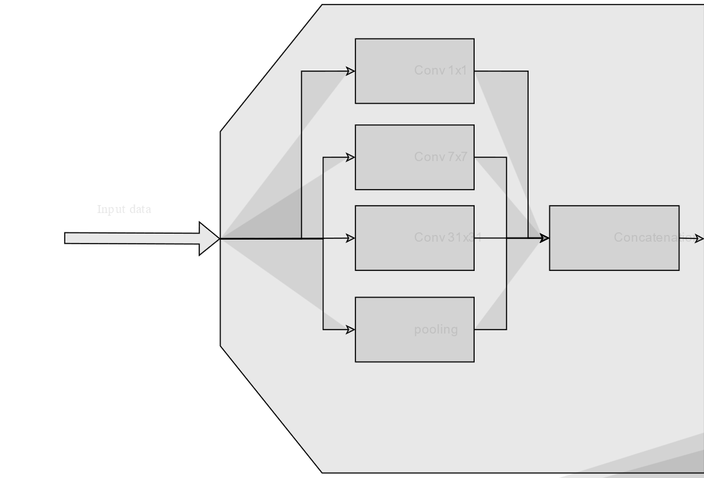
Network: The Koopman Evolution Matrix
According to Koopman Operator theory, the evolution matrix is a
0
0
0
0
0
Figure 4. Network’s Koopman Linear Layer(Image by Author).

Slide 7
Network: Normalization

Slide 8
Network: The Koopman Evolution Matrix
According to Koopman Operator theory, the evolution matrix is a
0
0
0
0
0
Figure 4. Network’s Koopman Linear Layer(Image by Author).

Slide 9
Introduction: The Koopman Operator
FLOPS
Compare eigenvalues of DMD/EDMD/HankelDMD with Koopman and RBF
Noise robustness

